Slide 1


Unsupervised Learning: Exploring the Unknown
Unsupervised learning is a powerful AI technique that allows models to discover hidden patterns and insights within complex, unlabeled data. By uncovering these unseen structures, we can gain a deeper understanding of our world and unlock new possibilities.
by K. Adithya

Slide 2
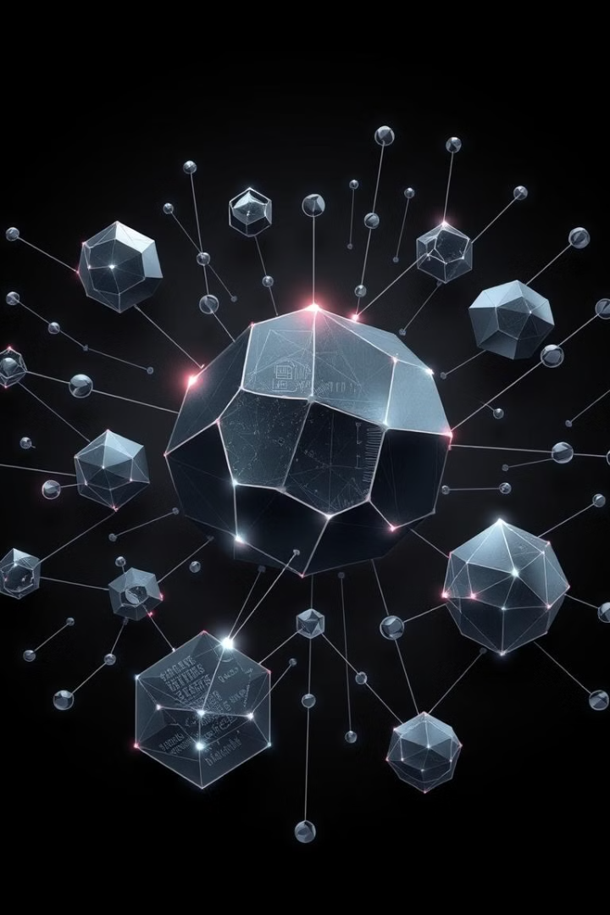
What is Unsupervised Learning?
No Labels
Discover Patterns
Unsupervised learning algorithms work with data that has no pre-defined labels or targets, allowing the model to independently identify meaningful structures.
These models uncover hidden patterns, clusters, and relationships within the data, revealing insights that may not be obvious to the human eye.
Flexible Approach
Exploratory Analysis
Unsupervised learning is highly adaptable, allowing it to tackle a wide range of problems, from segmentation to anomaly detection.
This technique is invaluable for exploratory data analysis, where the goal is to gain a deeper understanding of the underlying structure of the data.

Slide 3
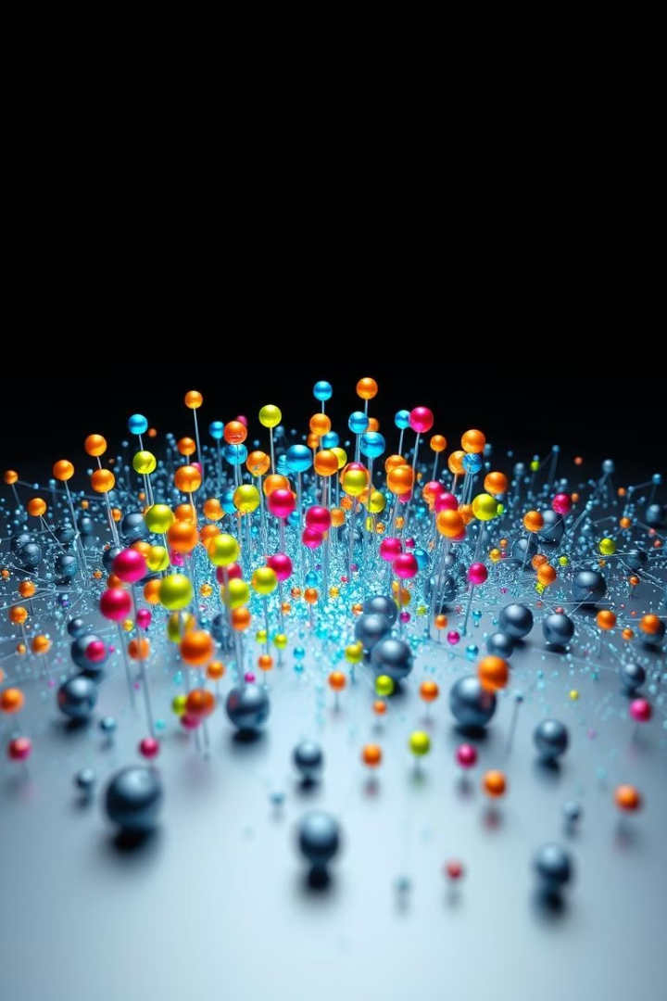
Clustering Algorithms: Grouping Data
1
K-Means
Partitions the data into k clusters based on similarity, with each data point assigned to the nearest centroid.
2
Hierarchical Clustering
Builds a hierarchy of clusters, allowing for the exploration of data at different levels of granularity.
3
DBSCAN
Identifies clusters based on density, making it effective at finding arbitrary-shaped clusters and detecting outliers.

Slide 4
Dimensionality Reduction: Simplifying Complexity
Principal Component Analysis (PCA)
t-SNE
Autoencoders
t-SNE is a nonlinear technique that preserves the local structure of the data, making it effective for visualization.
Neural network-based models that learn a compressed representation of the input, enabling dimensionality reduction.
PCA projects high-dimensional data onto a lower-dimensional space while preserving the maximum amount of variance.

Slide 5
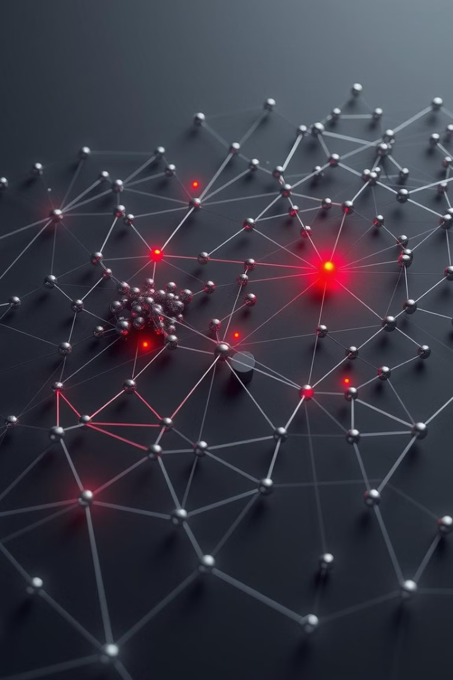



Anomaly Detection: Identifying Outliers
Isolation Forest
One-Class SVM
An ensemble method that identifies anomalies based on how easily they can be isolated from the rest of the data.
A support vector machine-based approach that learns a boundary around the "normal" data to detect outliers.
Density-Based Techniques
Autoencoder-Based
Methods that identify anomalies as data points in low-density regions, deviating from the high-density clusters.
Neural network models that learn a compressed representation of the data and flag inputs with high reconstruction error as anomalies.

Slide 6




Generative Models: Creating New Data
Variational Autoencoders (VAEs)
VAEs learn a probabilistic model of the data, allowing them to generate new samples that resemble the training data.
Generative Adversarial Networks (GANs)
GANs pit two neural networks against each other - a generator and a discriminator - to create realistic synthetic data.
Normalizing Flows
These models transform simple probability distributions into more complex ones, enabling them to generate diverse and high-quality samples.

Slide 7

Applications of Unsupervised Learning
1
Market Segmentation
2
Recommendation Systems
Clustering algorithms can identify distinct customer groups, enabling more targeted marketing strategies.
Unsupervised techniques can uncover hidden relationships in user data to provide personalized product recommendations.
3
Anomaly Detection
4
Image and Text Analysis
Identifying outliers in data can help detect fraud, system failures, or other unusual events.
Dimensionality reduction and generative models can be used for tasks like image generation, text summarization, and more.

Slide 8
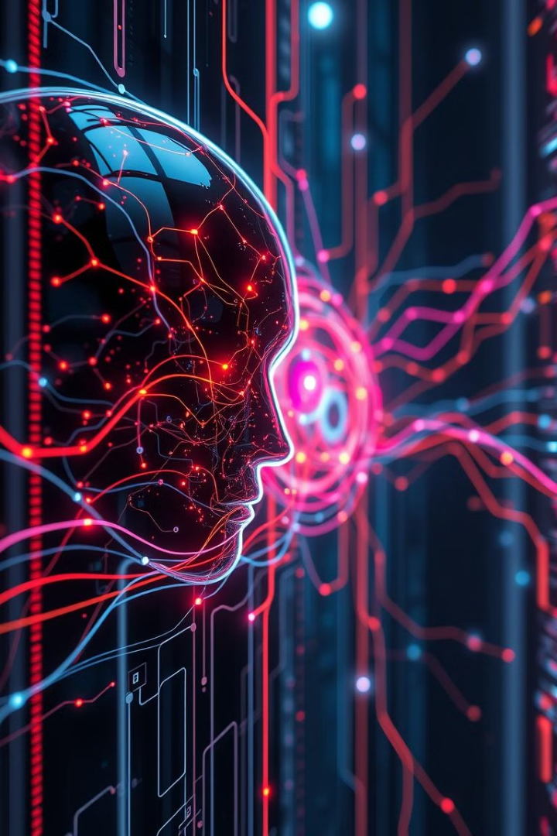
The Future of Unsupervised Learning
As computing power and data availability continue to grow, the potential for unsupervised learning to uncover hidden insights and drive innovation is boundless. From automating tedious tasks to enabling creative breakthroughs, this field of AI holds immense promise for the future.

